Slide 1
ownCloud Server 9.0
The safest home for all your data
Notes:
Welcome everybody

Slide 2

About Me
Notes:
A bit about me, the speaker

Slide 3
Agenda
Why and what of ownCloud
ownCloud Server 9.0
  Innovative Collaboration
  Ultimate Scalability
  Full Federation
Go get it!
Notes:
Agenda:
Good and bad of cloud
Value of privacy
And what you can do to protect it: use ownCloud!
Then what's new in 9.0

Slide 4
The good and bad of the cloud
Notes:
Start with the awesomeness of the cloud. Do I need to tell you?

Slide 5
Awesomeness of the cloud
Accessible everywhere
Back up online
Easy sharing and collaboration
All free!!!
  (or super cheap)
Notes:
Android phone breaks – log in on new
Games online
Chatting, sharing pics or documents with others
Free or cheap!

Slide 6
Awfulness of the cloud
Where is my data? (“cloud is just another word for somebody elses' computer”)
Who can access my data? (NSA/China/businesses/thieves)
How is my data used? (it says more about you than you think)
Notes:
But ask yourself these questions. We're living post-Snowden so I hope I don't have to talk much more about this...

Slide 7
Public Policy doesn't help at all
"We are all vulnerable to everyone because the NSA wanted us to be vulnerable to them."
- Bruce Schneier
Notes:
One note, because it keeps coming.
Police should have a back door.
No, they should NOT: decrease security for all.
Self-fulfilling prophecy: it is like suggesting to not lock our doors so that if a burglary is in progress the feds can more easily enter our house.
We have ONE infrastructure. There is no world where the US gets to spy but the Chinese can't.
We are secure, or vulnerable.
An example has been in Greece: they had phone back doors which were then used by criminals to find out what judges were against them – and kill them.
So back doors are a BAD IDEA, period.

Slide 8
Take back your data
Notes:
You should be convinced now:
Cloud is awesome
But endangers privacy
And privacy matters
You know what you need: something you OWN.

Slide 9

Introducing ownCloud
Sync and share
Open Source
Easy to use
Easy to install
Easy to extend
>8 mln users
Notes:
So, here's one such solution: ownCloud
Core: sync and share data
Ticks more boxes
Including what we discussed earlier

Slide 10


Easy to use
Easy to deploy: LAMP
Easy to hack on or inspect: PHP, JS, CSS
All-platform access
Scale from Raspberry Pi to CERN
Great user interface
Notes:
Easy. I can't emphasize this enough: this is core to ownCloud. Do what the user expects. If it isn't easy, and BETTER than the alternative, I wouldn't use it and neither will most people. So we strive to make it as easy and comfortable as possible. A real modern, efficient and intuitive web experience.
It is also very flexible and, of course, cross-platform.

Slide 11
Capabilities
External Storage
  FTP, NFS, WebDAV, dropbox, S3, …
  Encryption
  Versioning
Sharing
  Public link, password/expire, upload rights, comments, tags, notifications...
Server to server sharing
Notes:
External Storage
* FTP, NFS, WebDAV, dropbox, S3, …
* Encryption
* Versioning
Sharing
Friends took pictures at your wedding?
Send them a public link, expiring in 2 months, protected with a password for uploading files!
Let them comment and discuss the pics!
Server to server sharing
3 German universities: 500K students, one cloud.
Federation and decentralization!

Slide 12
Extensible
over 200 ownCloud Apps
calendar/contacts/real-time collaborative document editing/music player/password manager/feed reader/video player/notes/sketching/presentation player/SMS sender/backup/transmission client/and so on and on and on and on
apps.owncloud.com
Notes:
ownCloud is a platform you can build apps on
Over 200 available
Top ten has 12 to 28K downloads

Slide 13
Yours
Open Source
Millions of users
Since 2010
  950+ contributors, >350 in last year
  github.com/owncloud
  ownCloud Inc. for enterprise
Notes:
Most central point: YOU OWN IT.
Fully open
Development on github
AGPL
Etc.
ownCloud Inc offers Enterprise edition with a limited subset of apps which are supported
And set integration tools with proprietary enterprise tools like shibboleth, Oracle Databases and Microsoft Sharepoint.

Slide 14
New in 9.0
Notes:
So let’s talk about what’s new in 9.0.
The three biggest areas of improvement in this release are the improved collaboration features, the increased scalability and the changes to federation.

Slide 15
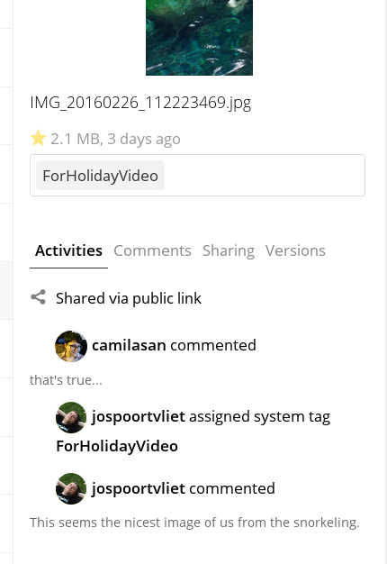
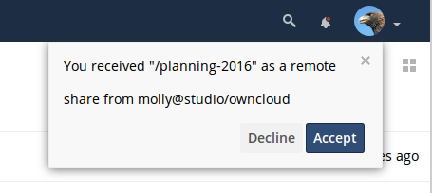
Innovative Collaboration
Comments
Tags
Activity and notifications
Notes:
First – collaboration.
You can now comment on files and folders to discuss them with others. You’ll get notified in the file view that there are new comments.
Speaking off, we’ve updated notifications – you now have a little bell next to your user name if there’s news like shares you received from somebody.
This is separated from the activity feed, which now also shows comments and tags.
Tags are also new and you can use them to organize your files and find them more quickly.

Slide 16
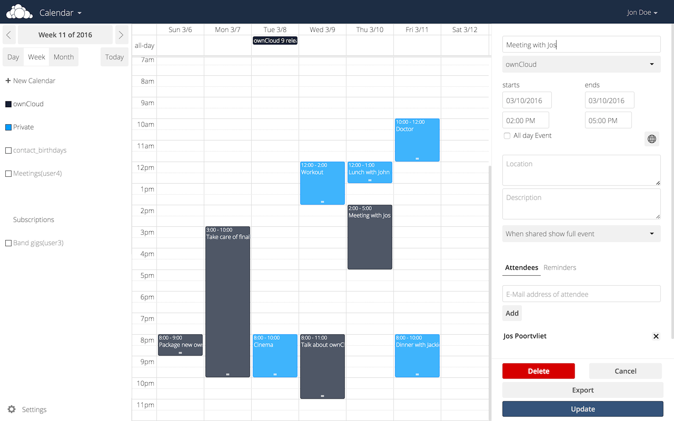
App works – rewritten calendar
Notes:
We also improved several of the ownCloud apps. The calendar was rewritten, with the core functionality of syncing CalDAV merged in the core and the UI turning into a pure Javascript app.
Feedback on the new calendar is very welcome – and if you have suggestions or code, this is the time to get involved, we got a fresh and modern code base!

Slide 17
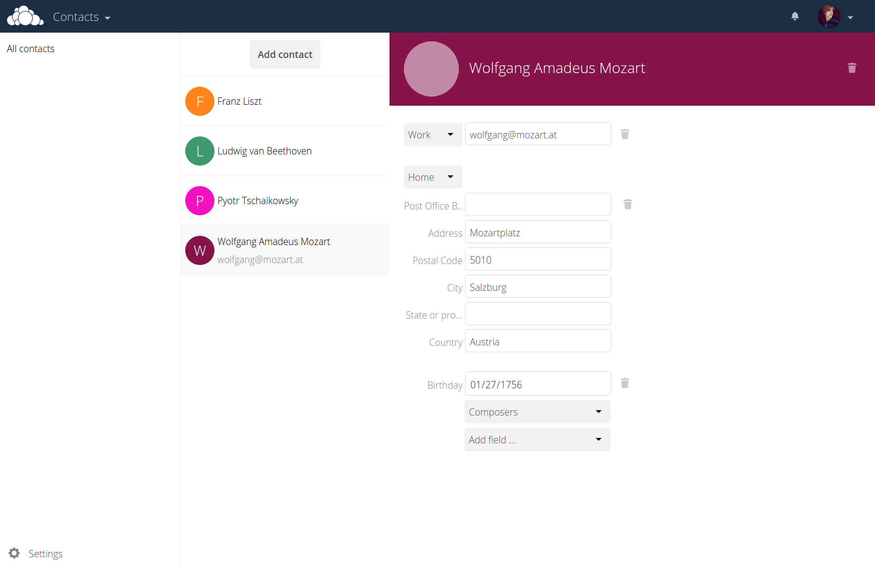
App works – rewritten contacts
Notes:
The same goes for the Contacts app – the CardDAV syncing functionality is now part of core and the app is a pure javascript tool. Your input is super valued!

Slide 18
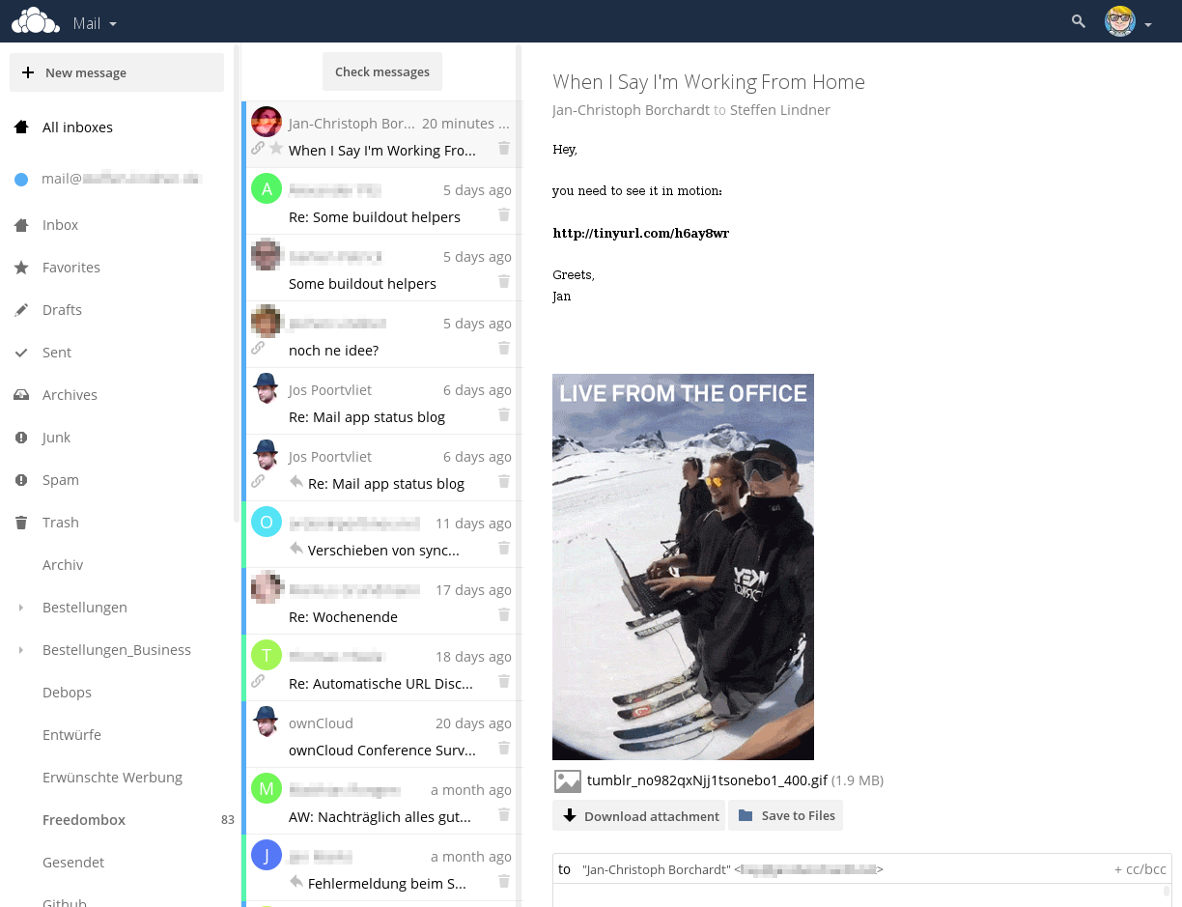
App works – Mail is Coming!
Notes:
Last but not least, work on ownCloud Mail is progressing. We’re building this on the Horde libraries and welcome your input.

Slide 19

Ultimate Scalability
Work done with CERN to break the petabyte barrier
Integrate storage deeper in ownCloud with new API’s
Improved, simpler, faster sharing API
Smashing particles into each other under the Swiss alps to determine the nature of the universe! Generates petabytes of data to be studied by scientists across the globe.
Notes:
The second area with major improvements is performance, or rather, scalability – the ability to work with massive amounts of data and users.
We worked with CERN, atomsmashers in Switzerland – they have worlds’ largest particle accelerator there doing scientific experiments that generate so much data, they first had to invent the internet and now they’re working with us to share this data between all the thousands of scientists all over the world working on the analysis and processing of it.
They work very closely with us, openly in github and we’re very proud and grateful for that. They have great engineers and worked with us before on Smashbox, a tool for automatic testing of file syncing.

Slide 20
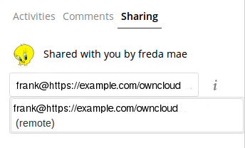
Full Federation
Federation =
sharing across ownCloud servers like they are one!
Use ‘Federated Cloud ID’ to share with others.
Better than ever: once you shared once with another server, it will sync users with yours and auto complete user names!
Notes:
The third area of improvement is Federation.
Federation refers to the ability of independent ownCloud servers to act as one server: you can share files with somebody else on another server by entering their Federated Cloud ID, that is like an email address – it has the same form, like <username> AT <server>.
We made a great step forward: ownCloud 8.2 would already store names of people you shared with in the address book to auto complete them next time. ownCloud 9 goes further: the first time you connect to a new server, it exchanges address books so you can use auto complete on all users on both servers!
Administrators can control this, of course, disabling it or adding trusted servers by hand.

Slide 21
And more
New, stand-alone updater for smoother upgrades from 9.0.1 and onward
Code Signing to verify the integrity of your ownCloud server
Improved error reporting by occ command line tool
Many small UI enhancements
Much, much more
Notes:
Last but not least, there is a bunch of smaller changes, which are actually huge in themselves, just small compared to the big three we already talked about.
First, there is a new upgrade app which will make upgrading your ownCloud faster and more reliable. It will first get to work when upgrading to ownCloud 9.0.1.
Second, we have added Code Signing functionality, checking the integrity of an installation to detect problems earlier and improve the security of apps – apps can be signed and this secures them from being changed without their authors’ consent.
There are many more smaller improvements all over in ownCloud 9.0 – try it and you will see!

Slide 22
Get it
Info: owncloud.org
Code: owncloud.org/install
Test drive: demo.owncloud.org
Join: owncloud.org/contribute
Learn: doc.owncloud.org
Business: owncloud.com
Notes:
Join us, get your ownCloud, get some apps and take back your data!

Slide 23

June 22-26
https://owncloud.org/hackathon/
Notes:
Join us, get your ownCloud, get some apps and take back your data!

Slide 24
Questions?
Notes:
Thank you!

